Slide 1
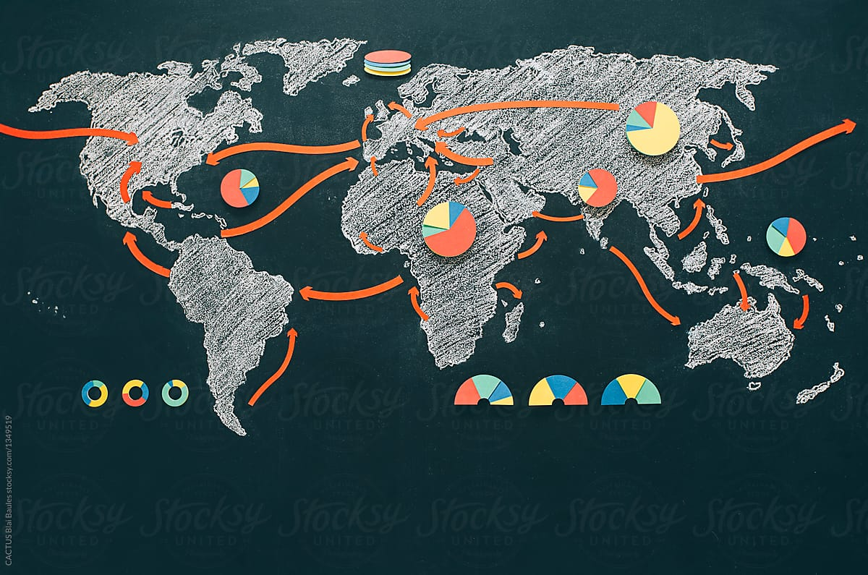
Neighborhood Recommender
Final Project
Battle of the Neighborhoods
Coursera Capstone Project

Slide 2

OUTLINE
INTRODUCTION
DATA
METHODOLOGY
RESULTS
DISCUSSION
CONCLUSION

Slide 3
INTRODUCTION
Objective: The goal of this project is to build a neighborhood recommendation system.
This project presents a solution to those who want to move from one city to another either for personal or business reasons.
Even though the project is focused only on Toronto and New York, the idea can be applied on any set of cities.

Slide 4
Data
There are two main data sets:
1. New York Neighborhoods: ready to use
2. Toronto Neighborhoods: Scraped from a Wiki page
Venue data will be added to each neighborhood in both data sets.
The venue categories will be hot encoded in order to calculate the similarity index.
Both cities data sets should be made to have the same number of categories in order to have the same size vectors.

Slide 5
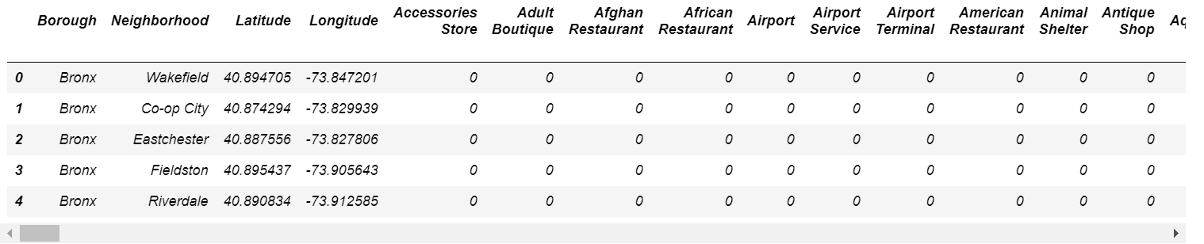
New York Data

Slide 6
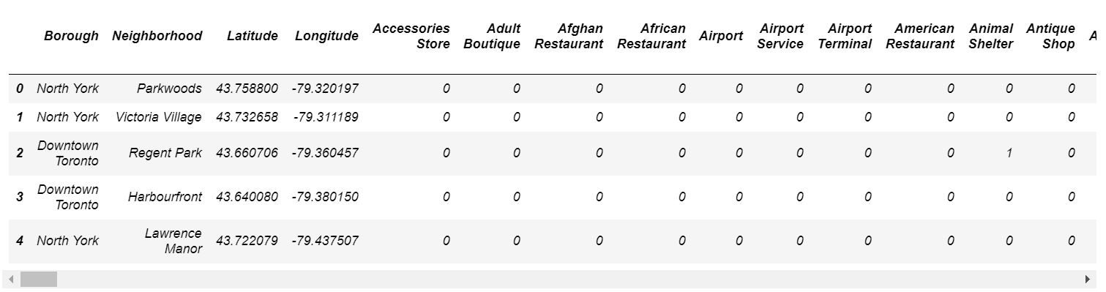
Toronto Data

Slide 7
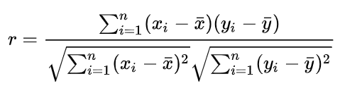
Methodology
Pearson Correlation Coefficient will be used as a similarity measure
It is used to measure the strength of a linear association between two variables. The formula for finding this coefficient between sets X and Y with N values can be seen in the image below.

Slide 8

Methodology
The values given by the formula vary from r = -1 to r = 1, where 1 forms a direct correlation between the two entities (it means a perfect positive correlation) and -1 forms a perfect negative correlation.
Instead of writing a code to calculate Pearson Coefficient, SciPy provides a function to easily accomplish that.

Slide 9
Results
An individual is interested in moving from New York to Toronto. Currently, they live in Bensonhurst, Brooklyn, NY. The goal is to find similar neighborhood/s in Toronto to that of New York. The way this works is similar to a recommender system.
We call the similarity function, passing "nyc", "Brooklyn", and "Bensonhurst" as parameters. Below is the head of the sorted data frame returned by the function. Note that these are the five most similar neighborhoods as the data frame is sorted from the most similar to the most dissimilar. The "Similarity" column repesents the similarity index, which ranges from -1 (most dissimilar) to 1 (most similar).

Slide 10
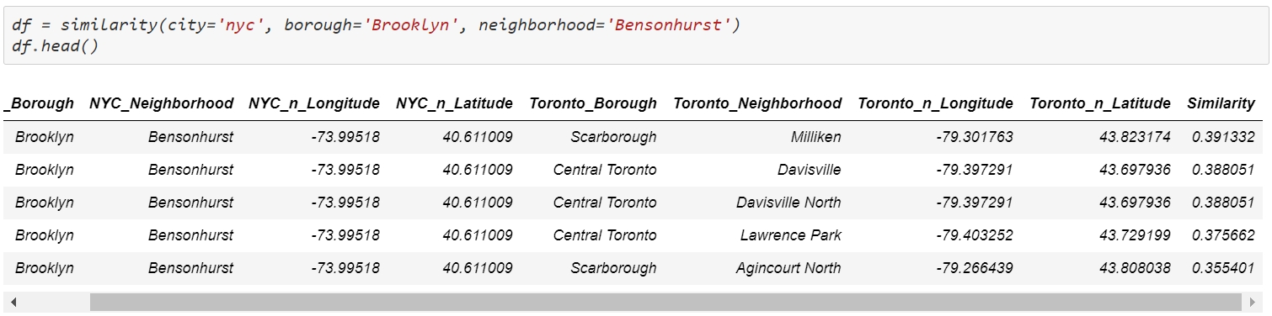
Results

Slide 11
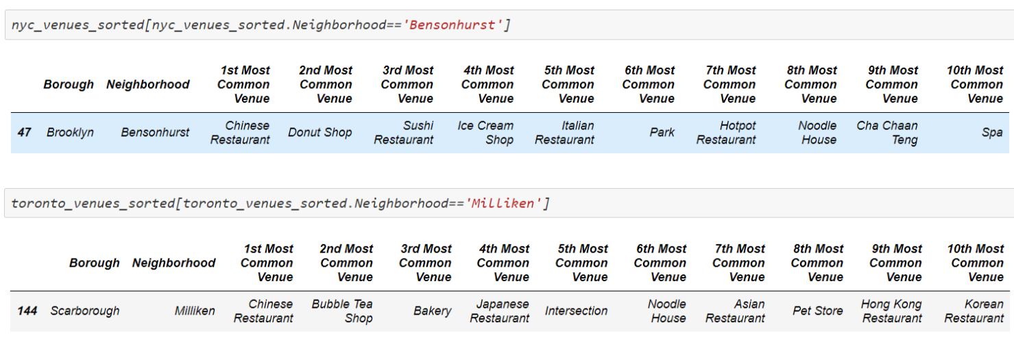
Results: Common Venues

Slide 12
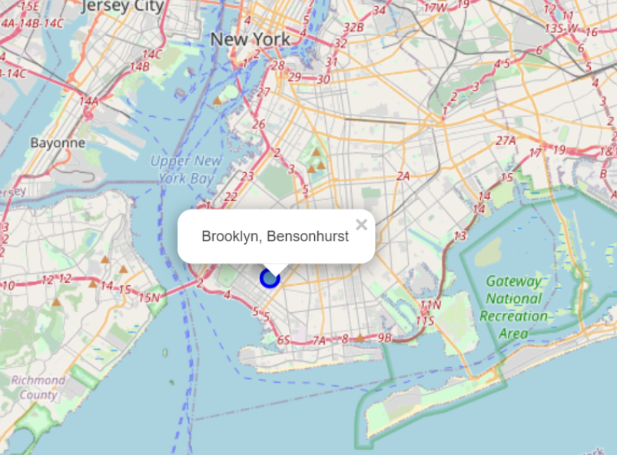
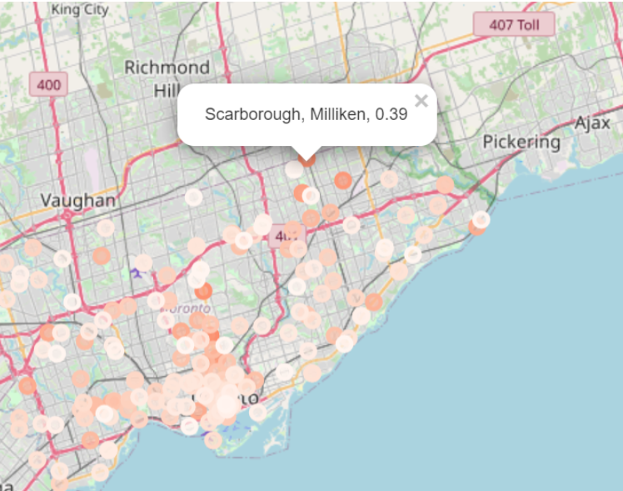
Results
As you can see, both neighborhoods feature Asian venues: Sushi, Chinese, and Japanese Restaurants. Also, they are both kind of suburban neighborhoods as shown in the two maps below.

Slide 13
Discussion
In the example, the similarity index is slightly in the low range (<60%) even for the most similar neighborhood.
There are many reasons for that including the large number of categories, 475.
More testing is needed to check which similarity measure best fit this problem, such as Euclidean distance and Jaccard Coefficient.
The two examples also show that Pearson coefficient is still a solid approach.

Slide 14
Conclusion
This project presented a simple and yet efficient approach to building a neighborhood recommender system.
Even though the system was based only on venue categories, more data can be added to make the system more efficient such as using demographic data of each neighborhoods.
The system can help businesses that are looking to scale up and open new branches by recommending neighborhoods based on the neighborhoods of the current successful branches.

